Slide 1
Cophylogenetic Reconciliation

Slide 2
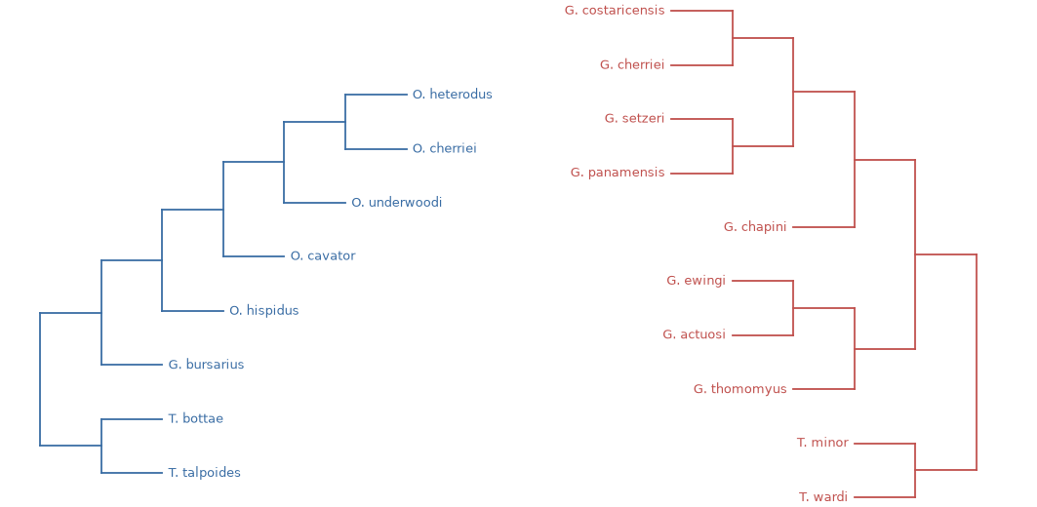
Mapping the parallel histories of linked species
The challenge - Reconstruct shared evolutionary past of host and parasite from both host and parasite trees and current mapping.
Do they speciate simultaneously?
Do parasite jump to new hosts?
How to reconstruct millions of years of invisible history?

Slide 3
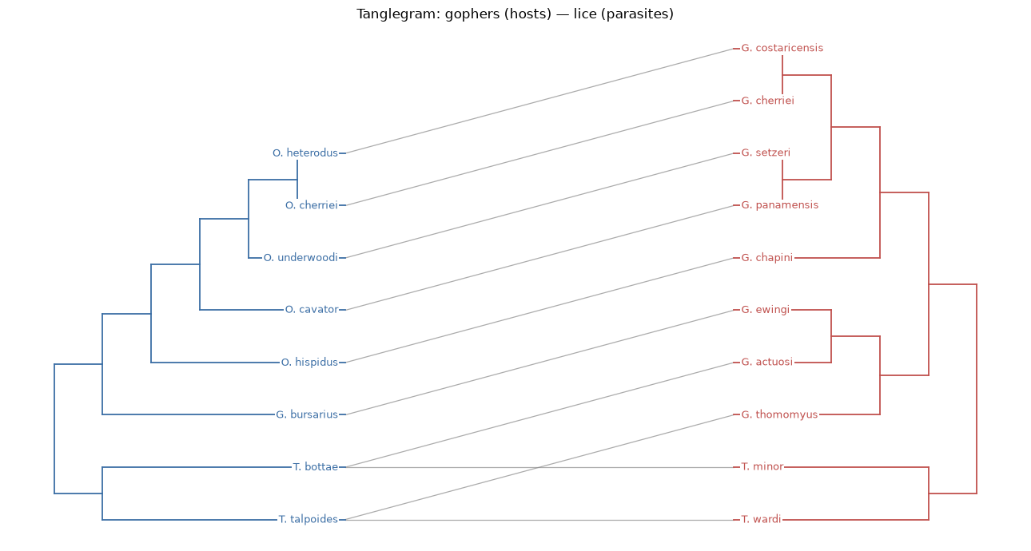
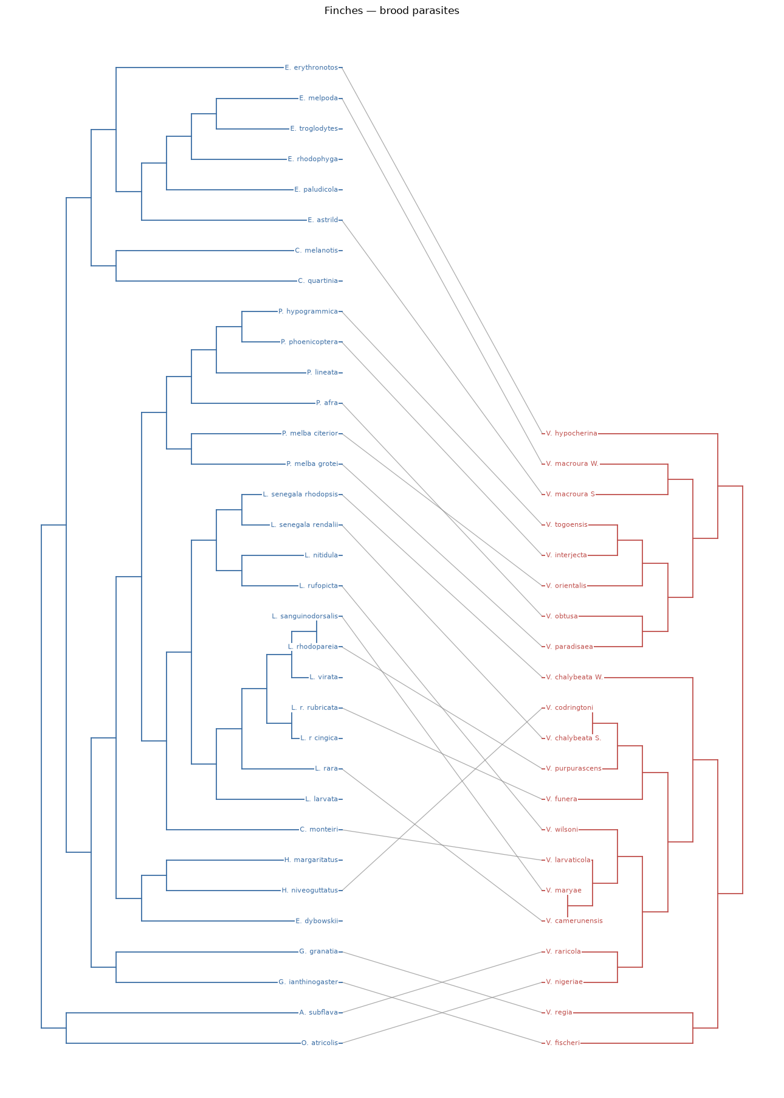
Order vs. Chaos in nature
High Congruence: Order
Low Congruence: Chaos
Gopher Louse system
Finches – Brood parasites

Slide 4
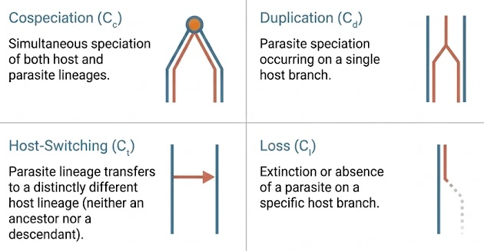
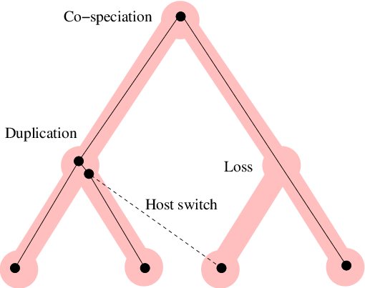
DTL model
Dynamic programming model, walk the parasite tree bottom-up (children before parents)

Slide 5
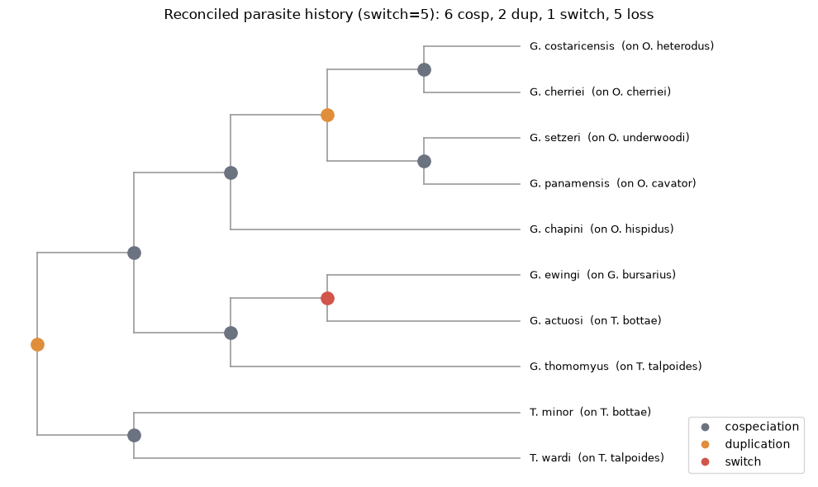
DTL Traceback Algorithm
Reconstructs specific evolutionary events at ancestral internal nodes.
The model infers a highly congruent history with only a single host-switch.
(Note: Losses occur along branches and do not form new splitting nodes)

